Slide 1
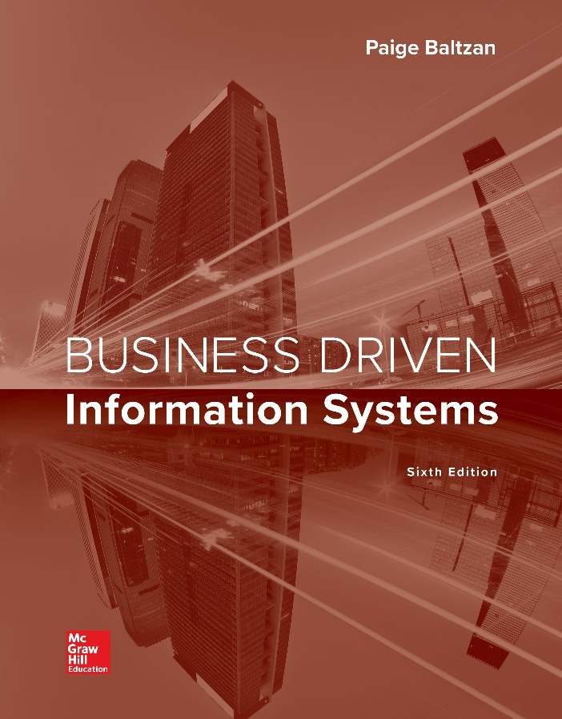
CHAPTER ONE
Management Information Systems:
Business Driven MIS
Notes:
This chapter sets the stage for the textbook. It starts from ground zero by providing a clear description of what information is and how it fits into business operations, strategies, and systems. It provides an overview of how companies operate in competitive environments and why they must continually define and redefine their business strategies to create competitive advantages. Doing so allows them to survive and thrive. Information systems are key business enablers for successful operations in competitive environments.
You, as a business student, must understand the tight correlation between business and technology. You must first recognize information’s role in daily business activities and then understand how information supports and helps implement global business strategies and competitive advantages. After reading this chapter, you should have a solid understanding of business driven information systems and their role in managerial decision making and problem solving.

Slide 2
Chapter One Overview
SECTION 1.1 – Business Driven MIS
Competing in the Information Age
The Challenge of Departmental Companies and the MIS Solution
SECTION 1.2 – Business Strategy
Identifying Competitive Advantages
The Five Forces Model – Evaluating Industry Attractiveness
The Three Generic Strategies – Choosing a Business Focus
Value Chain Analysis – Executing Business Strategies
Notes:
Information is everywhere.
Information is a strategic asset.
Without information, an organization simply could not operate.
This chapter introduces students to several core business strategies that focus on using information to gain a competitive advantage, including:
Data, Information, Knowledge, Business Intelligence
Competitive advantages
SWOT analysis
Porter’s Five Forces Model
Porter’s three generic strategies
Porter’s Value chain

Slide 3
Section 1.1
BUSINESS DRIVEN MIS
Notes:
CLASSROOM OPENER
Get your students talking and thinking about data
Ask your students what they think about the importance of data in the business world today
How much data is collected by Walmart every hour?
How much data does a Fitbit generate every day per user?
What types of data does a business require to be successful?
This course is about data and information systems that run worldwide global business – take time to explain the importance of this course for all business majors!!
Can an individual be successful in business today if they don’t know how to collect, cleanse, understand, and analyze data?

Slide 4
Learning Outcomes 1 of 2
1.1 Describe the information age and the differences among data, information, business intelligence, and knowledge.
1.2 Explain systems thinking and how management information systems enable business communications.

Slide 5
Competing in the Information Age 1 of 5
Did you know?
Avatar, the movie, took over 4 years to make and cost $450 million
Lady Gaga’s real name is Stefani Joanne Angelina Germanotta
It costs $2.6 million for a 30-second advertising time slot during the Super Bowl
Ask how many of your students are familiar with Siebel, Oracle, or PeopleSoft and can articulate what they can do for a company?商業雜誌到處是科技名詞
Notes:
Why do you think you need to study management information systems?
Technology is everywhere in business
Be sure to point out that the below exercise focuses on business magazines, not technology magazines, and yet they are filled with technology (MIS)
CLASSROOM EXERCISE
Understanding the Relevance of Technology In Business
This is a great exercise to begin the course. It clearly demonstrates why anyone involved in business must understand technology. It can be a real revelation for students who do not see the need for taking an MIS course.
Bring in several copies of BusinessWeek, Fortune, Forbes, or any popular business magazine. The magazines do not have to be current. Provide a marking tool such as a small set of Post-It Notes. Ask for a few volunteers and have the students review the magazine and stick a Post-It Note on each technology-related article, advertisement, etc. When the student has completed this task, the magazine will be covered in Post-it Notes, clearly demonstrating that technology is everywhere in business, even in the popular business magazines such as BusinessWeek.
Since this task can be time consuming, you can put in the Post-It Notes prior to class and simply show your students the completed magazine. You can have one student sit in the front of the class and begin the exercise, placing Post-It Notes on a copy of BusinessWeek. After they have completed several pages on their own, you can produce the same “completed” magazine with all of the Post-It Notes. This saves classroom time and still reinforces the point that technology is everywhere in business.
Be sure to reinforce that these are business magazines, not technology magazines. Yet they are completely filled with technology – which is clearly demonstrated by the Post-It Notes. How can any business student today possibly argue that they do not need to know or understand technology when faced with a magazine, such as BusinessWeek, that is filled with technology? Read a few of the articles or advertisements. Ask how many of your students are familiar with Siebel, Oracle, or PeopleSoft and can articulate what they can do for a company?
The goal of this course is to help your students understand the business side of technology. Being able to understand all of the technology articles in BusinessWeek is one of the benefits your students will receive upon completion of the course.

Slide 6
Competing in the Information Age 2 of 5
Fact - The confirmation or validation of an event or object
Information age - The present time, during which infinite quantities of facts are widely available to anyone who can use a computer
Notes:
CLASSROOM EXERCISE
Metrics on Business Magazines
Running metrics on current business magazines is an excellent way to demonstrate how much technology is everywhere in business. There are so many articles where you can run metrics to see how relevant MIS is in the working world from Fortune 100 companies, to Top 100 Companies to Launch a Career, to Hot Growth Markets. Just pick a current article and run the metrics comparing MIS to marketing, HR, accounting, etc. and prove how hot MIS is in the business environment.

Slide 7
Competing in the Information Age 3 of 5
Examples of the power of business and technology
Amazon – Not a technology company; primary business focus is selling books
Netflix – Not a technology company; primary business focus is renting videos
Zappos – Not a technology company; primary business focus is selling shoes
Zappos賣鞋的亞馬遜”。這位而立之年的華人小伙名叫謝家華，他開設的網路鞋店就是“Zappos
Notes:
You may think only students well versed in advanced technology can compete in the information age.
This is simply not true!
Many business leaders have created exceptional opportunities by coupling the power of the information age with traditional business methods.
Amazon’s founder, Jeff Bezos, at first saw an opportunity to change the way people purchase books. Using the power of the information age to tailor offerings to each customer and speed the payment process, he in effect opened millions of tiny virtual bookstores, each with a vastly larger selection and far cheaper product than traditional bookstores. The success of his original business model led him to expand Amazon to carry many other types of products.
The founders of Netflix and Zappos have done the same thing for videos and shoes. All these entrepreneurs were business professionals, not technology experts. However, they understood enough about the information age to apply it to a particular business, creating innovative companies that now lead entire industries.
CLASSROOM OPENER
GREAT BUSINESS DECISIONS – Apple’s Decision to Develop the First Saleable Personal Computer (PC)
Like all great computer companies, Apple began its life in a garage. In 1977, Steve Jobs and Steve Wozniak built the Apple 1, regarded by many as the first real personal computer. This founded the Apple Company and the invention of the Apple 2 and the Apple Macintosh. Apple’s key goal was to make computers accessible to ordinary people. Jobs and Wozniak captured an opportunity and changed the world through a combination of good fortune and technical and marketing brilliance.
Instead of writing commands in computer code, Apple owners invented a mouse to click on easily recognizable icons – for example, a trash can and file folders. Other companies were quick to copy Apple’s competitive advantage, including Microsoft.
The two founders eventually parted, with Wozniak leaving the company to become a teacher and Jobs continuing with the launch of the Apple Macintosh. Unfortunately, Macintosh captured only 20 percent of the desktop market, while Microsoft captured 80 percent of the desktop market with its MS-DOS operating system.
One newspaper described Jobs as a “corporate Huckleberry Finn” and said his early business exploits had already made him part of American folk history. John Sculley, former Pepsi chairman, removed Jobs from Apple in 1985. Sculley was removed from Apple in 1993. Eventually, after a 13-year exile, Jobs returned to Apple in 1998. The man who founded the company had come full circle and was now its only hope for survival.
Jobs’ return brought the creation of the iMac and Apple rediscovered its inventive originality. The iMac sold 278,000 units in the first six weeks and was described by Fortune as “one of the hottest computer launches ever.” The iMac and Jobs’ return contributed to doubling Apple’s share prices in less than a year.

Slide 8
Competing in the Information Age 4 of 5
Internet of Things (IoT) - A world where interconnected Internet-enabled devices or “things” have the ability to collect and share data without human intervention
Machine-to-Machine (M2M) - Refers to devices that connect directly to other devices
Notes:
Over 20 years ago a few professors at MIT began describing the Internet of Things (IoT), a world where interconnected Internet-enabled devices or “things” have the ability to collect and share data without human intervention.
To date, the 50 petabytes of data available on the Internet has been captured mostly by humans through such methods as typing, recording, and scanning text, photos, and voice recordings. Data entry is the process of gathering data from business documents and entering it into a computer. A vital process for any business. The issue with human data collection is the fact that humans make mistakes! Numbers are frequently transposed, addresses mistyped, and some files are skipped completely. Inaccurate data in a system will lead to incorrect reports and ultimately bad business decisions. Allowing computers to perform the data entry process greatly reduces human error. Computers are precise and accurate and would know when things need to be replaced, repaired, or recalled saving time and money for companies.

Slide 9
Competing in the Information Age 5 of 5
The core drivers of the information age:
Data
Information
Business intelligence
Knowledge
Notes:
The primary goal of this course is to arm your students with the knowledge they need to compete in the information age. Understanding data, information, BI, and knowledge are the core drivers of the information age.
When discussing MIS it is important to understand the difference between data and information
Ask your students to look around the classroom and identify 3 pieces of data and 3 pieces of information
This is a bit of a trick question. Unless you know the system you are building or the problem you are trying to solve it is impossible to know what is data and what is information
For example, if you were building a system to track students:
Data might include height, name, and hair color
Information might include student to professor ratio, percentage of marketing majors who are female, and number of students who pass the course
If you were building a system to track inventory:
Data might include chair manufacturer, chair color, and chair size
Information might include number of chairs required for students in each class and average number of chairs needed to be replaced each semester

Slide 10
Data 1 of 2
Data - Raw facts that describe the characteristics of an event or object
Structured data – Stored in a traditional system such as a relational database or spreadsheet
Machine-generated data – Created by a machine without human intervention
Human-generated data – Data that humans, in interaction with computers, generate
Notes:
Ask your students why raw data is useless without interpretation
What does it mean to interpret data?
What happens if the data you are analyzing is incorrect?
What does Garbage In is Garbage Out mean when referring to data?

Slide 11
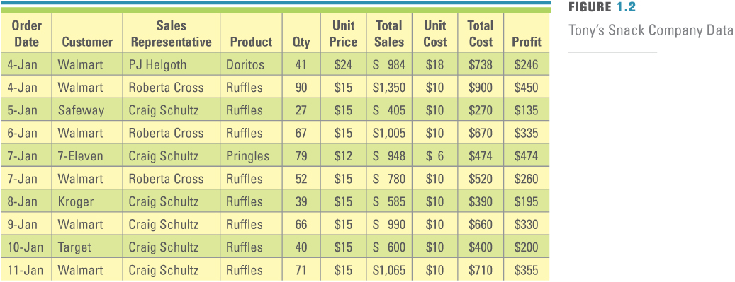
Figure 1.2 Tony’s Snack Company Data
Unstructured data – Not defined and does not follow a specified format
Doritos調味墨西哥玉米片, Ruffles褶饰洋芋片；花边; Pringles品客薯片
Notes:
The rows in an Excel spreadsheet demonstrate data, raw facts that describe the characteristics of an event or object
A fundamental role of all business managers is to be able to take the data and analyze it to find information to make great business decisions
Ask your student how a business uses data to improve decision making?
Review Tony‘s Snack Company Data and ask what types of questions they would want to answer to improve operations
What represents data?
The unit price for Doritos is one piece of data
The unit price for Ruffles is one piece of data
The unit cost for Doritos is one piece of data
The unit cost for Ruffles is one piece of data
The sales representative per order is one piece of data
Ask your students what is the difference between price and cost?
What would happen to a manager that only focuses on total sales, not total profit?

Slide 12
Data 2 of 2
Big data – A collection of large, complex data sets, including structured and unstructured data, which cannot be analyzed using traditional database methods and tools
Snapshot – A view of data at a particular point in time
快拍 簡要情況
Notes:
Data is the new Oil is a common phrase in business
Data is the new Soil is the new translation
What does this term mean?
What is different about big data?
What types of problems will business managers of the future encounter because of big data? (Analysis paralysis is a great discussion point)

Slide 13
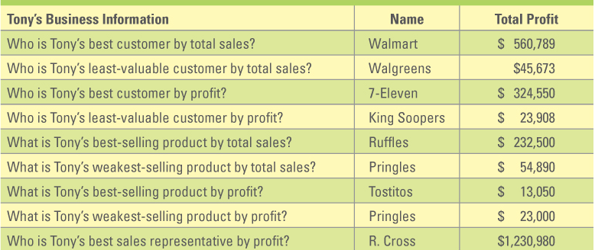
Figure 1.4 Information Gained after Analyzing Tony’s Data
Information - Data converted into a meaningful and useful context
Notes:
Data features, such as Auto filter, turn data into information
By turning Tony‘s Snack Company Data in the figure into information students should be able to answer the following questions
Who are my best customers?
Who are my least-profitable customers?
What is my best-selling product?
What is my slowest-selling product?
Who is my strongest sales representative?
Who is my weakest sales representative?
What business questions could Tony answer from this data?
Total products sold
Average unit price per product
Total costs
Total profit
Best sales representative
Worst sales representative

Slide 14
Information
Report – A document containing data organized in a table, matrix, or graphical format allowing users to easily comprehend and understand information
Static report – Creating once based on data that does not change
Dynamic report – Changes automatically during creation
Notes:
BI manipulates multiple variables and in some cases even hundreds of variables such as
Interest rates
Weather conditions
Gas prices
Ask your students what value a company can gain by analyzing additional variables such as the stock market or gas prices?
What types of business operations would be impacted by these variables?
Rows of data in an Excel spreadsheet demonstrate data
Show the students that this is simply data, it does not explain any types of information or business intelligence such as how much did each employee sell this month?
Who is the best customer?
What is the best product?
Managers use tools such as Pivot Tables in Excel, to find BI in data
It also allows us to find the answer to multi variable questions such as what is the best sales representative’s worst selling product?
This is a great example of the power of IT to run a business – ask your student the following questions:
Without the ability to analyze data how would a manager run a business?

Slide 15
Business Intelligence 1 of 3
Business intelligence - Information collected from multiple sources such as suppliers, customers, competitors, partners, and industries that analyzes patterns, trends, and relationships for strategic decision making
Notes:
BI manipulates multiple variables and in some cases even hundreds of variables such as
Interest rates
Weather conditions
Gas prices
Ask your students what value a company can gain by analyzing additional variables such as the stock market or gas prices?
What types of business operations would be impacted by these variables?
Rows of data in an Excel spreadsheet demonstrate data
Show the students that this is simply data, it does not explain any types of information or business intelligence such as how much did each employee sell this month?
Who is the best customer?
What is the best product?
Managers use tools such as Pivot Tables in Excel, to find BI in data
It also allows us to find the answer to multi variable questions such as what is the best sales representative’s worst selling product?
This is a great example of the power of IT to run a business – ask your student the following questions:
Without the ability to analyze data how would a manager run a business?

Slide 16
Business Intelligence 2 of 3
Analytics – The science of fact-based decision making
Descriptive analytics: describe past performance and history
Predictive analytics: extract information from data and use it to predict future trends and identify behavioral patterns
Prescriptive analytics: create models indicating the best decision to make or course of action to take
Notes:
Analytics is the science of fact-based decision making.
Business analytics is the scientific process of transforming data into insight for making better decisions.
Descriptive analytics use techniques that describe past performance and history.
Predictive analytics use techniques that extract information from data and use it to predict future trends and identify behavioral patterns.
Prescriptive analytics use techniques that create models indicating the best decision to make or course of action to take.

Slide 17
Business Intelligence 3 of 3
Descriptive Analytics
Techniques that describe past performance and history
Example: Creating a report that includes charts and graphs that explains data
Predictive Analytics
Techniques that extract information from data and use it to predict future trends and identify behavioral patterns
Example: Using past sales data to predict future sales data
Prescriptive Analytics
Techniques that create models indicating the best decision to make or course of action to take
Example: Airline using past purchasing data as inputs into a model that recommends the best pricing strategy across all flights allowing the company to maximize revenue.
Notes:
Be sure your students understand that descriptive analytics focuses on past data to predict the future or understand business today
Predictive analytics use past data to predict the future
Prescriptive analytics use today’s data to make the optimal business decision based on efficiency and effectiveness

Slide 18
Knowledge
Knowledge - Skills, experience, and expertise coupled with information and intelligence that creates a person’s intellectual resources
Knowledge worker – Individual valued for their ability to interpret and analyze information
Notes:
Imagine that Tony analyzes his data and finds his weakest sales representative for this period is Craig Schultz. If Tony considered only this information, he might conclude that firing Craig was a good business decision. However, because Tony has knowledge about how the company operates, he knows Craig has been out on medical leave for several weeks; hence, his sales numbers are low. Without this additional knowledge, Tony might have executed a bad business decision, delivered a negative message to the other employees, and sent his best sales representatives out to look for other jobs.
The key point in this scenario is that it is simply impossible to collect all the information about every situation, and yet without that, it can be easy to misunderstand the problem. Using data, information, business intelligence, and knowledge to make decisions and solve problems is therefore the key to finding success in business. These core drivers of the information age are the building blocks of business systems.
Ask your students to name different types of knowledge workers found in today’s companies
Ask your students to name a few types of workers that are not knowledge workers found in today’s companies
Ask your students if they consider themselves knowledge workers, why or why not

Slide 19
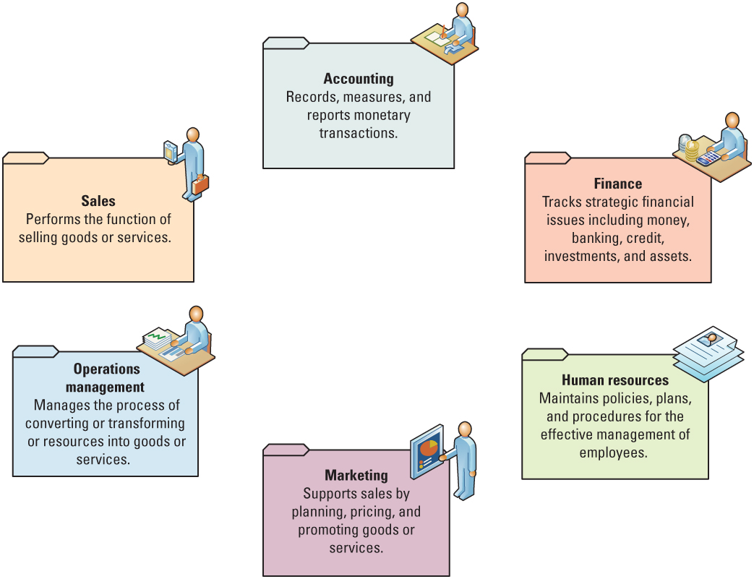
Figure 1.7 Departments Working Independently
People, information, and technology are inextricably linked
Information is one of the most important assets in an organization, and the primary way that people get information is through information technology
Notes:
Ensure your students know what processes each department is responsible for performing
Ask your students to identify a few issues a company might encounter if its departments work independently
Data in and of itself is not useful unless the right people know how to use and manage it efficiently and effectively
People, information, and technology are inextricably linked
If one fails, they all fail
What is one of the most important assets in an organization?
Information is one of the most important assets in an organization, and the primary way that people get information is through information technology
Without databases and spreadsheets how would managers gather, correlate, and analyze information?
Manually
Performing these tasks manually, or by hand, is extremely time consuming

Slide 20
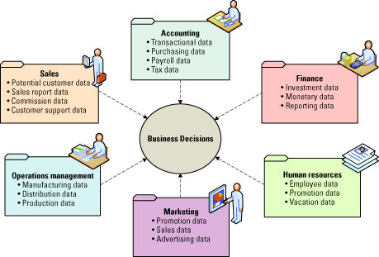
Figure 1.8 Departments Working Together
Successful companies operate cross-functionally, integrating the operations of all departments.
Systems are the primary enabler of cross-functional operations
Notes:
Successful companies operate cross-functionally, integrating the operations of all departments.
Systems are the primary enabler of cross-functional operations.
Ask your students to explain how a company operated prior to computers. How did marketing provide information to sales without computers? How did accounting collect information to create financial statements without computers or email?
Explain the numerous ways that systems help distribute information around a company improving operational efficiency and effectiveness.
Employees across departments trust each other to use information (especially about problems and failures) to improve performance.
Employees across departments search for information to better understand the future and align themselves with current trends and new directions.
Employees across departments are open to new insights about crisis and radical changes and seek ways to create competitive advantages.

Slide 21
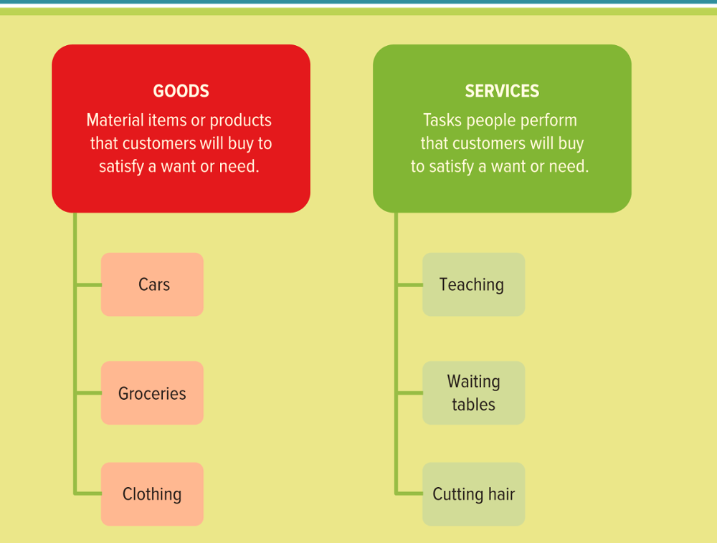
Figure 1.9 Different Types of Goods and Services
Jump to long image description
Notes:
Goods are material items or products that customers will buy to satisfy a want or need. Clothing, groceries, cell phones, and cars are all examples of goods that people buy to fulfill their needs.
Services are tasks performed by people that customers will buy to satisfy a want or need.
Waiting tables, teaching, and cutting hair are all examples of services that people pay for to fulfill their needs.
Ask your students to list several types of goods.
Ask your students to list several types of services.

Slide 22
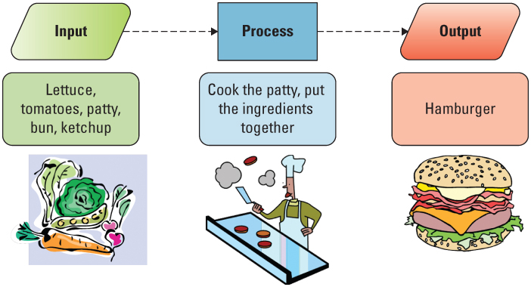
Figure 1.10 Input, Process, Output Example
bun圓形麵包, patty肉饼, lettuce生菜,萵苣tomato, ketchup番茄醬
Notes:
Production is the process where a business takes raw materials and processes them or converts them into a finished product for its goods or services.
Ask your students to explain the process of making a hamburger including:
Inputs - such as the bun, patty, lettuce, tomato, and ketchup
Process - cook the patty, wash and chop the lettuce and tomato, and place all of the items in the bun.
Outputs - your hamburger!
Productivity is the rate at which goods and services are produced based upon total output given total inputs.
Ask your students how a hamburger restaurant can improve productivity.
Answer: if a business could produce the same hamburger with less expensive inputs or more hamburgers with the same inputs it would see a rise in productivity and possibly an increase in profits.
Ensuring the input, process, and output of goods and services work across all of the departments of a company is where systems add tremendous value to overall business productivity

Slide 23
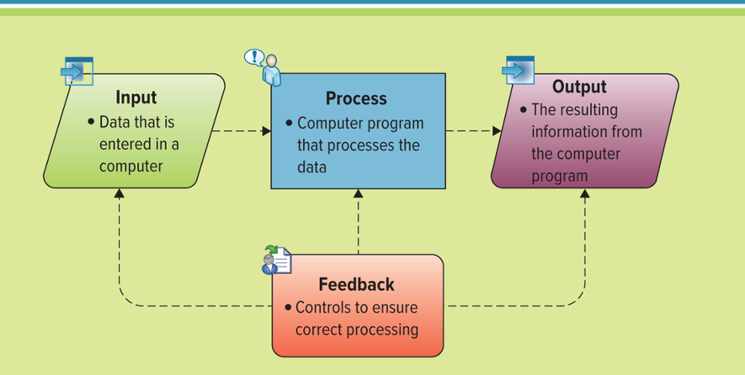
Figure 1.11 Overview of Systems Thinking
Systems thinking – A way of monitoring the entire system by viewing multiple inputs being processed or transformed to produce outputs while continuously gathering feedback on each part
Jump to long image description
Notes:
Successful companies operate cross-functionally, integrating the operations of all departments. Systems are the primary enabler of cross-functional operations. A system is a collection of parts that link to achieve a common purpose. A car is a good example of a system, since removing a part, such as the steering wheel or accelerator, causes the entire system to stop working.
Systems thinking is a way of monitoring the entire system by viewing multiple inputs being processed or transformed to produce outputs while continuously gathering feedback on each part (see Figure). Feedback is information that returns to its original transmitter (input, transform, or output) and modifies the transmitter’s actions. Feedback helps the system maintain stability. For example, a car’s system continuously monitors the fuel level and turns on a warning light if the gas level is too low. Systems thinking provides us with an end-to-end view of how operations work together to create a product or service. Business students who understand systems thinking are valuable resources because they can implement solutions to problems that consider the entire process, not just a single component
System: A collection of parts that link to achieve a common purpose
Feedback: Information that returns to its original transmitter (input, transform, or output) and modifies the transmitter's actions
Ask your students to provide several real-world examples of systems thinking
Example: A car, coffee maker, washer and dryer, On Demand movies

Slide 24
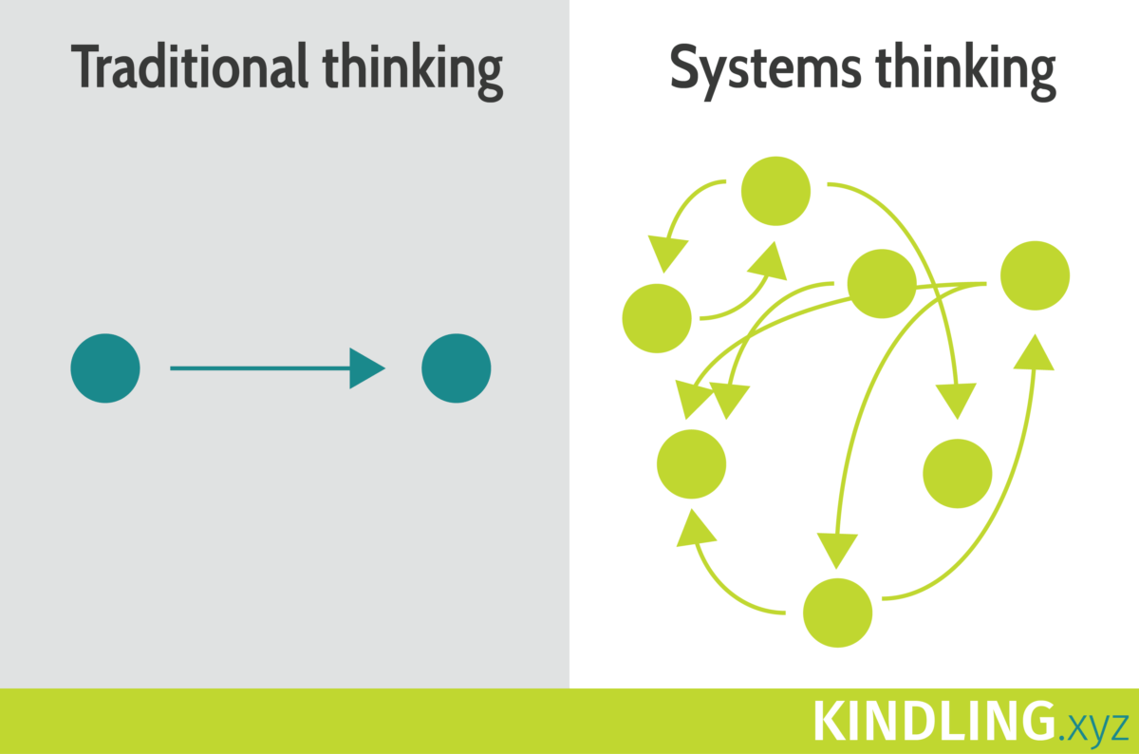
Systems Thinking
Management Information Systems (MIS) – A business function, like accounting and human resources, which moves information about people, products, and processes across the company to facilitate decision-making and problem-solving
Notes:
MIS is not technology
MIS is a business function
Most organizations have a department that is responsible for performing the MIS function
This is similar to an organization having an Accounting department that is responsible for performing the accounts payable and accounts receivable functions

Slide 25
五項修練的故事
本書的作者哈欽斯(David Hutchens)---身兼學習設計師、溝通顧問等多重身分、才華洋溢的作家----因此協同插畫家龔伯特 (Bobby Gombert)，製作了這一系列、從九歲到企業執行長都讀得津津有味的《五項修練的故事》。
比狼學得快，對應自我超越。
旅鼠的困境，對應建立使命與共同願景。
穴居人的陰影，對應心智模式。
冰山的一角，對應系統思考。
聆聽火山的聲音，對應團隊學習。

Slide 26
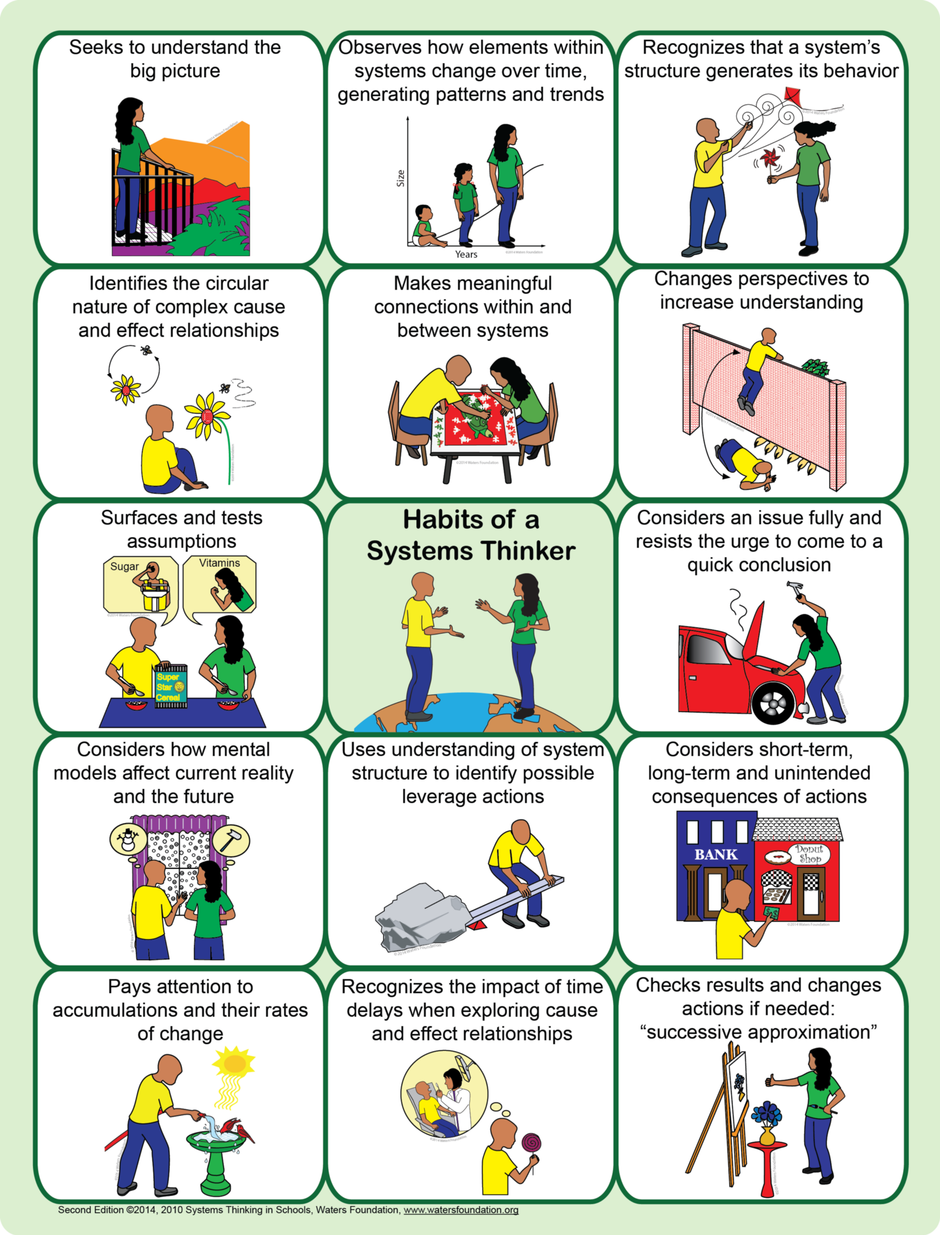
14 Habits of a Systems Thinker
Notes:
Resist the urge克制願望

Slide 27
第五項修煉：
1. 系統思維 2. 自我超越 3. 心智模式 4. 共同願景 5. 團隊學習 彼得聖吉（Peter Senge）於 1990提出

Slide 28
心智模式 換個角度看世界
行到水窮處、坐看雲起時。
瞭解自己、傾聽他人意見，保持開放的心胸。
內省：瞭解自己的心智模式！

Slide 29
MIS Department Roles and Responsibilities 1 of 2
Chief information officer (CIO) – Oversees all uses of IT and ensures the strategic alignment of IT with business goals and objectives
Chief knowledge officer (CKO) - Responsible for collecting, maintaining, and distributing the organization’s knowledge
Chief privacy officer (CPO) – Responsible for ensuring the ethical and legal use of information
Notes:
Explain to your students that job titles, roles, and responsibilities often differ dramatically from organization to organization
The CIO typically reports directly to the Chief Executive Officer (CEO)
CIOs must possess a solid and detailed understanding of every aspect of an organization coupled with tremendous insight into the capability of IT
CIOs must have strong business skills and strong IT skills
Can you name any famous CEOs?
Jeff Bezos, Amazon.com
Bill Gates, Microsoft
Michael Dell, Dell computers
Can you name any famous CIOs?
Most students will be familiar with many famous CEOs but not CIOs, CPOs, CSOs, CKOs, or CTOs

Slide 30
MIS Department Roles and Responsibilities 2 of 2
Chief security officer (CSO) – Responsible for ensuring the security of IT systems
Chief technology officer (CTO) – Responsible for ensuring the throughput, speed, accuracy, availability, and reliability of IT
Chief intellectual property officer
Chief automation officer
Chief user experience officer
Notes:
While many companies may not have a different individual for each of these positions, they must have top managers who take responsibility for all of these areas.
Define the difference between the CIO, CTO, CSO, CPO, and CKO
CIO oversees all uses of IT and ensures the strategic alignment of IT with business goals and objectives
CTOs are similar to CIOs, except CIOs take on the additional responsibility for effectiveness of ensuring that IT is aligned with the organization's strategic initiatives
CTOs ensure the efficiency of IT
CPOs are the newest senior executive position, and many CPOs are lawyers by training
CKO is one of the most recent positions added to the executive leadership team
Define the general organizational structure between CIO, CTO, CSO, CPO, and CKO
This structure will vary from organization to organization
A great debate is to have the entire class decide on an organizational structure, including the CFO and CEO for a fictitious company

Slide 31
Section 1.2
BUSINESS STRATEGY
Notes:
CLASSROOM OPENER
GREAT BUSINESS DECISIONS – Cyrus McCormick’s Reaper
On a hot summer day in 1831, several dozen farmers and hired laborers gathered in a wheat field in Virginia to watch a horse-drawn wood-and-iron device mow down rows and rows of golden wheat. On this day, twenty-two-year-old Cyrus McCormick demonstrated the reaper that his father invented and changed history as the mechanization of farming began. Soon the process of industrialization began, which turned the nation’s economy into the world’s most productive workforce. As the historian William Hutchinson noted, “Of all the inventions during the first half of the nineteenth century which revolutionized agricultures, the reaper was probably the most important.”
Interestingly, the McCormicks were not the only individuals to build and develop a reaper. In fact, many other companies and individuals developed similar technology; however, Cyrus McCormick invented the business of making reapers and selling them to the farmers of America and foreign countries. His real genius was in the area of gaining and protecting patents for his technology. McCormick turned the reaper into a commercially viable product and introduced many new business practices including free trials, money-back guarantees, and installment payment plans.

Slide 32
Learning Outcomes 2 of 2
1.3 Explain why competitive advantages are temporary.
1.4 Identify the four key areas of a SWOT analysis.
1.5 Describe Porter’s Five Forces Model and explain each of the five forces.
1.6 Compare Porter’s three generic strategies.
1.7 Demonstrate how a company can add value by using Porter’s value chain analysis.

Slide 33
Identifying Competitive Advantages 1 of 2
Business strategy – A leadership plan that achieves a specific set of goals or objectives such as
Developing new products or services
Entering new markets
Increasing customer loyalty
Attracting new customers
Increasing sales
Notes:
Competitive advantage – a product or service that an organization’s customers place a greater value on than similar offerings from a competitor
First-mover advantage – occurs when an organization can significantly impact its market share by being first to market with a competitive advantage
Competitive advantages are important for an organization
It is even more important to understand that competitive advantages are typically temporary since competitors are quick to copy competitive advantages
Can you list a few companies that achieved success through competitive advantages?
United was the first airline to offer a competitive advantage with its frequent flyer mileage (this first-mover advantage was temporary)
Sony had a competitive advantage with its portable stereo systems (this first-mover advantage was temporary)
Microsoft had a competitive advantage with its unique Windows operating system
Does Microsoft still has a competitive advantage with its Windows operating system?
Perhaps – primarily due to its first-mover advantage since it is difficult to switch operating systems and users face interoperability issues if they are using different operating systems at the same organization.
How many students in your class are currently using Windows?
What are the competitors to Windows?
Linux and Macintosh
Why are there only three primary competitors in this large operating system market?
What would happen if you had 50 different operating systems to choose from?
Issues with interoperability
How many different types of Microsoft Office would be required to support all 50 different operating systems?
50

Slide 34
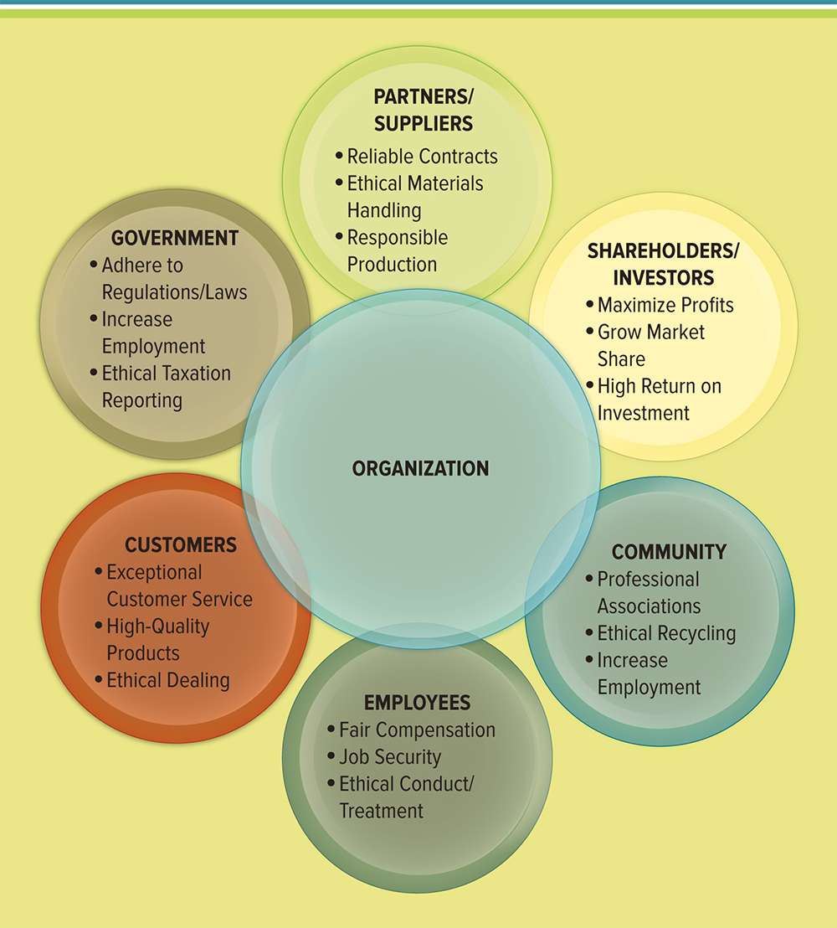
Figure 1.13 Stakeholders Interests
Jump to long image description
Notes:
Stakeholders’ Interests
Explain each area and how difficult it can be to ensure all needs and requirements are met.
A business strategy is a leadership plan that achieves a specific set of goals or objectives
This figure displays a number of business strategies that companies pursue
Ask your students to identify current companies and try to analyze their business strategies
Netflix
Airbnb
Uber
Amazon
Walmart
Target
iTunes

Slide 35
Identifying Competitive Advantages 2 of 2
Competitive advantage – A product or service that an organization’s customers place a greater value on than similar offerings from a competitor
First-mover advantage – Occurs when an organization can significantly impact its market share by being first to market with a competitive advantage
Notes:
Competitive advantages are important for an organization
It is even more important to understand that competitive advantages are typically temporary since competitors are quick to copy competitive advantages
Can you list a few companies that achieved success through competitive advantages?
United was the first airline to offer a competitive advantage with its frequent flyer mileage (this first-mover advantage was temporary)
Sony had a competitive advantage with its portable stereo systems (this first-mover advantage was temporary)
Microsoft had a competitive advantage with its unique Windows operating system
Does Microsoft still has a competitive advantage with its Windows operating system?
Perhaps, primarily due to its first-mover advantage since it is difficult to switch operating systems and users face interoperability if they are using different operating systems at the same organization.
How many students in your class are currently using Windows?
What are the competitors to Windows?
Linux and Macintosh
Why are there only three primary competitors in this large operating system market?
What would happen if you had 50 different operating systems to choose from?
Issues with interoperability
How many different types of Microsoft Office would be required to support all 50 different operating systems?
50

Slide 36
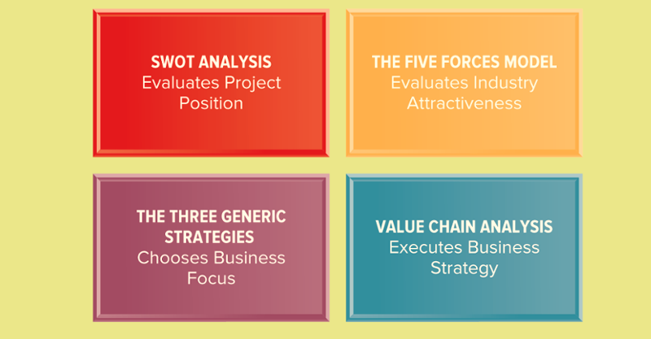
Figure 1.14 Business Tools for Analyzing Business Strategies
Jump to long image description
Notes:
The four competitive advantages discussed in this chapter include SWOT analysis, the Five Forces Model, the Three Generic Strategies, and the Value Chain Analysis.
Environmental scanning is the acquisition and analysis of events and trends in the environment external to an organization.
Technology has the opportunity to play an important role in environmental scanning for competitive intelligence.
For example, Frito-Lay, a premier provider of snack foods such as Cracker Jacks and Cheetos, does not just send its representatives into grocery stores to stock shelves. They carry handheld computers and record the product offerings, inventory, and even product locations of competitors. Frito-Lay uses this information to gain business intelligence on everything from how well competing products are selling to the strategic placement of its own products.
Ask your students why they would use a SWOT analysis
Ans: to evaluate a project position
Ask your students why they would use the five forces model
Ans: to evaluate the attractiveness of an industry
Ask your students why they would use the three generic strategies
Ans: to choose a business focus – example Walmart uses a low-cost strategy
Ask your students why they would use a value chain analysis
Ans: to execute business strategies

Slide 37
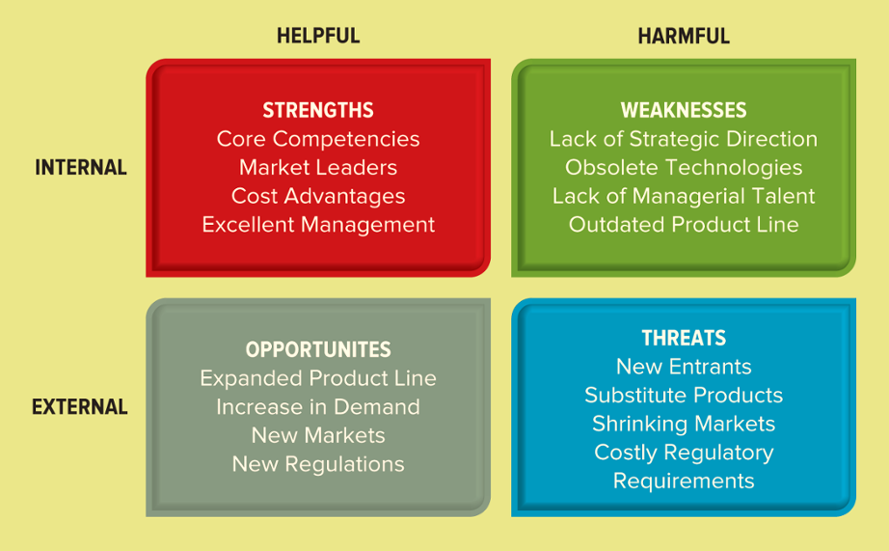
Figure 1.15 Sample SWOT Analysis
A SWOT analysis evaluates an organization’s strengths, weaknesses, opportunities, and threats to identify significant influences that work for or against business strategies
Jump to long image description
Notes:
Strengths and weaknesses originate inside an organization, or internally.
Opportunities and threats originate outside an organization, or externally and cannot always be anticipated or controlled.
Ask your students to complete a SWOT analysis.

Slide 38
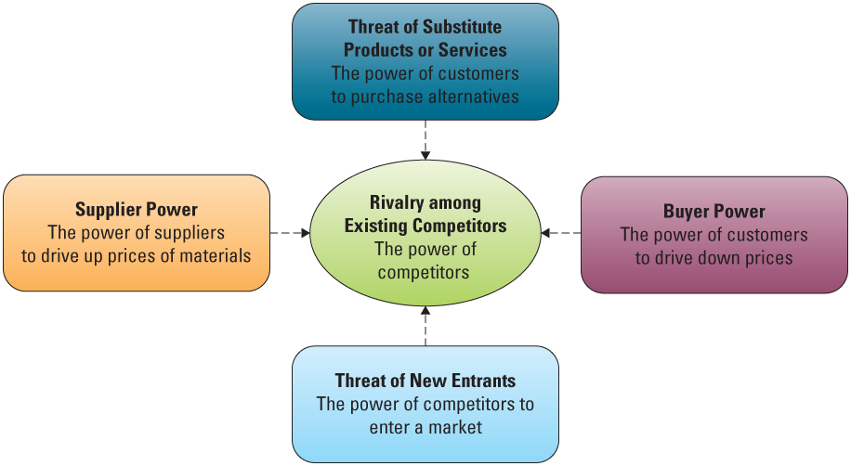
Figure 1.16 Porter’s Five Forces Model
Jump to long image description
Notes:
CLASSROOM EXERCISE
Analyzing Porter’s Five Forces
Porter's Five Forces is an easy framework to understand and offers a quick way to analyze a market. Porter’s Five Forces was introduced in the text and you can review the below examples to ensure you have a solid understanding of each force. For this assignment, choose a product from the following list and perform a Porter’s Five Forces analysis. Feel free to use the below Porter’s Five Forces template for your assignment.
Laptop
Fitbit
Cell Phone
Polaroid Camera
Telephone
Textbook
Be sure to add in examples of loyalty programs or switching costs you could implement to help retain your market share.

Slide 39
Buyer Power
Buyer power – The ability of buyers to affect the price of an item
Switching cost – Manipulating costs that make customers reluctant to switch to another product
Loyalty program – Rewards customers based on the amount of business they do with a particular organization
Notes:
Buyer power can also be called customer power
Calling buyer power customer power sometimes helps students understand the difference between buyer power and supplier power
To reduce buyer power (and create a competitive advantage), an organization must make it more attractive for customers to buy from them than from their competition
One of the best IT-based examples is the loyalty programs that many organizations offer
Which kinds of loyalty programs are you currently using?
Frequent-flyer miles
Grocery store discounts, such as a “Safeway Card”
Restaurant discounts such as Subway’s get your 12th sandwich free
Coffee clubs where you get your 10th cup of coffee free

Slide 40
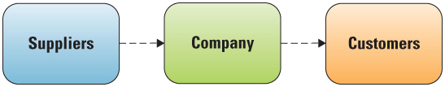
Figure 1.17 Traditional Supply Chain
Supplier power – The suppliers’ ability to influence the prices they charge for supplies
Supply chain – Consists of all parties involved in the procurement of a product or raw material
Notes:
A supplier organization in a market will want buyer (customer) power to be low
The supplier wants to be able to set any price it wants for its goods, and if buyers (customers) have low power, then they do not have any choice but to pay the high price since there are only one or two suppliers
What is an example of an organization with “high” supplier power?
Microsoft, Government regulated products such as energy markets, and telecommunication markets in some countries
How an organization can be both a supplier and a buyer in a supply chain?
Discuss how Dell computers is both a buyer and supplier in the supply chain
Dell is a buyer (customer) of parts, and a supplier to its customers who buy computers
If supplier power is high, the supplier can influence the industry by:
Charging higher prices
Limiting quality or services
Shifting costs to industry participants

Slide 41
Threat of Substitute Products or Services
Threat of substitute products or services – High when there are many alternatives to a product or service and low when there are few alternatives
Notes:
Ideally, an organization wants to be in a market in which there are few substitutes for its products or services
This is difficult to achieve, and most organizations create a competitive advantage through switching costs. The more painful it is for a customer to switch suppliers, the less likely they are to switch
If a customer has to experience pain when switching to a different service provider, then they are unlikely to switch
For example, switching doctors usually involves sending all medical records and explaining all past medical history to the new doctor. Insurance also has to be transferred, along with detailed forms that the customer will be required to complete (such as family history, personal history, HIPAA, etc.) For these reasons customers have to be extremely dissatisfied with a doctor before they will endure the pain of finding or switching to a new doctor
Students typically confuse rivalry with substitute products so be sure to ask students for examples of substitute products
What would be a substitute product for Starbuck’s coffee?
Jamba Juice
Tea House
Vitamin drink
Soda

Slide 42
Threat of New Entrants
Threat of new entrants – High when it is easy for new competitors to enter a market and low when there are significant entry barriers
Entry barrier – A feature of a product or service that customers have come to expect and entering competitors must offer the same for survival
Notes:
What is an industry that has a high entry barrier?
Energy: the organization has to have the infrastructure to support energy
Telecommunications: the organization has to invest in a telecommunications infrastructure prior to offering services
Banking: the bank must offer its customers an array of IT-enabled services including ATMs and online account services
What is an industry that has a low entry barrier?
Restaurants: simply lease a space, obtain a license, and you can sell food
Catering: simply offer food and deliver
Movie rental: simply buy the movies, pay the licensing fee, and offer the movies for rental (although if you want to be a Netflix the entry barrier is high because you have to have the facilities and systems to mimic their movie supply chain)

Slide 43
Rivalry Among Existing Competitors
Rivalry among existing competitors – High when competition is fierce in a market and low when competitors are more complacent
Product differentiation – Occurs when a company develops unique differences in its products or services with the intent to influence demand
Notes:
What are a few industries where competition is high?
Restaurants, products, telecommunications, banking
What are a few industries where competition is low?
This is typically highly regulated industries such as energy markets and stock exchanges
Ask your students to provide a few examples of differentiation
Different brands of Coke, Ragu spaghetti sauce, Pepsi
Additional features on a cell phone
GREAT BUSINESS DECISIONS – Henry Luce Decides to Rank Companies in the Fortune 500
Henry Luce founded Time magazine in 1923 and Fortune magazine in 1929. Luce decided to create a ranking of America’s top 500 companies, called The Fortune 500, which has served as the corporate benchmark for the twentieth century – as well as being a clever marketing tactic for the magazine. The Fortune 500 remains a powerful barometer of who’s up and down in the corporate world. It is also a brilliant marketing tool since every single time its name is mentioned, so is the name of the magazine. However, being ranked on the Fortune 500 does not guarantee that the organization will achieve future success, and its measures of current achievement can also be limited and a bit confusing.
BusinessWeek magazine created a similar ranking by introducing its biannual ranking of business schools. The issue routinely outsells all other issues of the magazine in the year.

Slide 44
Analyzing the Airline Industry
Perform a Porter’s Five Forces analysis of each of the following for a company entering the commercial airline industry
Buyer power
Supplier power
Threat of substitute products/services
Threat of new entrants
Rivalry among competitors
Notes:
Potential Answers Include:
Buyer Power: high, many airlines to choose from
Supplier Power: high, limited manufacturers, unions
Threat of Substitute products/services: high, many alternate transportation choices
Threat of new Entrants: high, new airlines enter market continuously
Rivalry among competitors: high, online sales
CLASSROOM EXERCISE
Porter’s Five Forces
Ask your students to name a few industries where competition is high?
Restaurants, products, telecommunications, banking
Ask your students to name a few industries where competition is low?
This is typically highly regulated industries such as energy markets and stock exchanges
Porter’s Five Forces is an easy framework to understand and offers students a quick way to analyze a business. Porter’s Five Forces is also reinforced throughout the text and it is important that your students have a solid understanding of each force. For this exercise, break your students into groups and ask them to choose two products to perform a Porter’s Five Forces analysis. The two products must compete in the same market.
Potential Products
Laptop Computer and Desktop Computer
PDA and Laptop Computer
iPod and Walkman
DVD Player and VCR Player
Digital camera and Polaroid Camera
Cell Phone and Blackberry PDA
Coca-Cola Plastic Bottle and Coca-Cola Glass Bottle
GPS Device and a Road Atlas
Roller skates and Rollerblades
Digital Books to Printed Books
Digital Paper to Paper

Slide 45
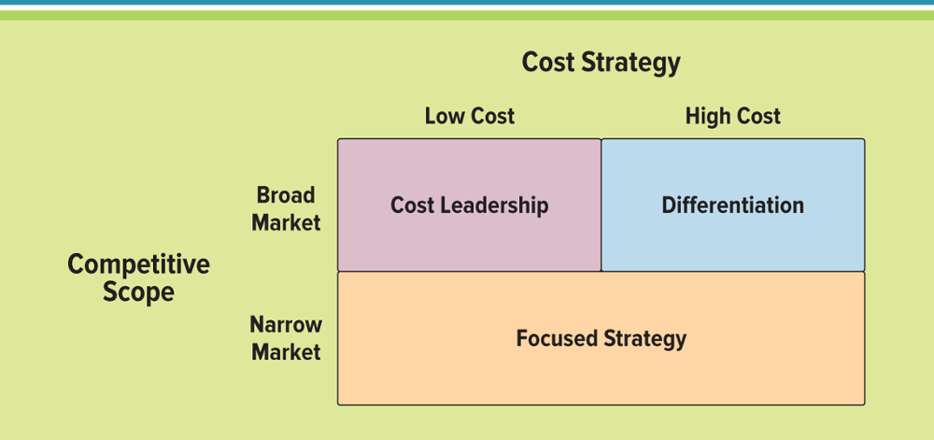
Figure 1.20 Porter’s Three Generic Strategies
Jump to long image description
Notes:
It is important to explain to your students that organizations are encouraged to follow only one of the three strategies
What would happen to Mercedes Benz if it wanted to follow a broad cost leadership and a focused strategy?
Mercedes Benz would find itself facing the dilemma of attempting to market and sell a highly specialized and expensive product at a discounted price. It simply wouldn’t work!
Organizations typically follow one of Porter’s three generic strategies when entering a new market
Broad cost leadership
Broad differentiation
Focused strategy

Slide 46
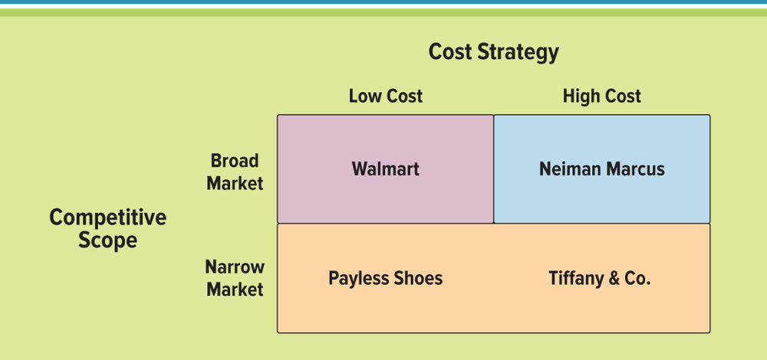
Figure 1.21 Examples of Porter’s Three Generic Strategies
Jump to long image description
Notes:
Broad strategies reach a large market segment
Focused strategies target a niche market
Focused strategies concentrate on either cost leadership or differentiation
Ask your students to choose an industry such as fast food or potato chips and perform a Porter’s Three Generic Strategies analysis

Slide 47
Value Chain Analysis – Executing Business Strategies 1 of 3
Business process – A standardized set of activities that accomplish a specific task, such as a specific process
Value chain analysis – Views a firm as a series of business processes that each add value to the product or service
Notes:
Business process: a standardized set of activities that accomplish a specific task, such as processing a customer’s order
Value chain: views an organization as a series of processes, each of which adds value to the product or service for each customer
Value Chain Groups: Within a company separate the company’s activities into two categories
primary value activities
support value activities
To create a competitive advantage, the value chain must enable the organization to provide unique value to its customers
Examining the organization as a value chain determines which activities add value for customers
The organization can then focus specifically on those activities

Slide 48
Value Chain Analysis – Executing Business Strategies 2 of 3
Primary value activities
Inbound logistics - Acquires raw materials and resources, and distributes
Operations - Transforms raw materials or inputs into goods and services
Outbound logistics - Distributes goods and services to customers
Marketing and sales - Promotes, prices, and sells products to customers
Service - Provides customer support
Notes:
Organizations typically follow one of Porter’s three generic strategies when entering a new market
Broad cost leadership
Broad differentiation
Focused strategy
Broad strategies reach a large market segment
Focused strategies target a niche market
Focused strategies concentrate on either cost leadership or differentiation

Slide 49
Value Chain Analysis – Executing Business Strategies 3 of 3
Support value activities
Firm infrastructure – Includes the company format or departmental structures, environment, and systems
Human resource management – Provides employee training, hiring, and compensation
Technology development – Applies MIS to processes to add value
Procurement – Purchases inputs such as raw materials, resources, equipment, and supplies
Notes:
Organizations typically follow one of Porter’s three generic strategies when entering a new market
Broad cost leadership
Broad differentiation
Focused strategy
Broad strategies reach a large market segment
Focused strategies target a niche market
Focused strategies concentrate on either cost leadership or differentiation

Slide 50
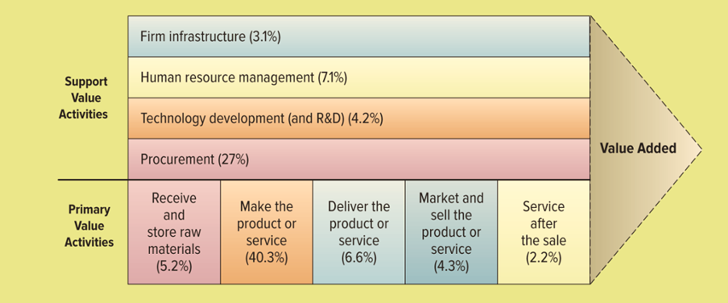
Figure 1.22 The Value Chain
Jump to long image description
Notes:
Primary value activities acquire raw materials and manufacture, deliver, market, sell, and provide after-sales services
Support value activities support the primary value activities
Customers determine the extent to which each activity adds value to the product or service
The competitive advantage is to:
Target high value-adding activities to further enhance their value
Target low value-adding activities to increase their value
Perform some combination of the two

Slide 51
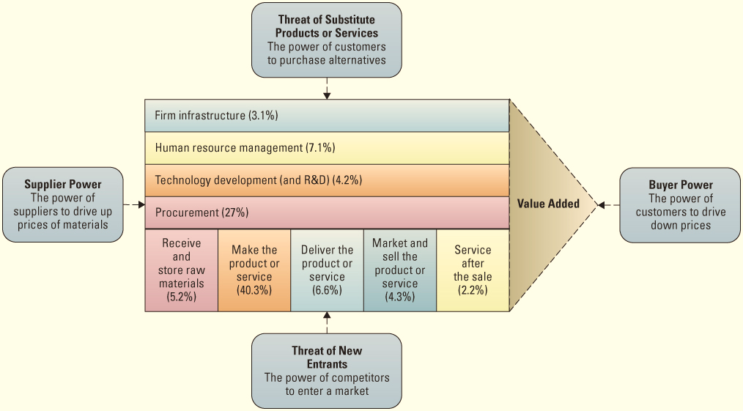
Figure 1.23 The Value Chain and Porter’s Five Forces Model
Jump to long image description
Notes:
If an organization wants to decrease its buyer’s or customer’s power, it can construct its value chain activity of “service after the sale” by offering high levels of quality customer service
This will increase the switching costs for its customers, thereby decreasing their power (buyer power)

Slide 52
Learning Outcome Review
Now that you have finished the chapter please review the learning outcomes in your text.

Slide 53
Appendix of Image Long Descriptions

Slide 54
Appendix 1 Figure 1.7 Departments Working Independently
Accounting - Records, measures, and reports monetary transactions
Finance - Tracks strategic financial issues including money, banking, credit, investments, and assets
Human Resources - Maintains policies, plans, and procedures for the effective management of employees
Marketing - Supports sales by planning, pricing and promoting goods or services
Operations Management - Manages the process of converting or transforming resources into goods and services
Sales - Performs the function of selling goods or services
Return to original slide

Slide 55
Appendix 2 Figure 1.8 Departments Working Together
Accounting
Transactional data
Purchasing data
Payroll data
Tax data
Finance
Investment data
Monetary data
Reporting data
Human Resources
Employee data
Promotion data
Vacation data
Marketing
Promotion data
Sales data
Advertising data
Operations Management
Manufacturing data
Distribution data
Production data
Sales
Potential customer data
Sales report data
Commission data
Customer support data
Return to original slide

Slide 56
Appendix 3 Figure 1.9 Different Types of Goods and Services
Goods
Material items or products that customers will buy to satisfy a want or need
Examples: cars, groceries, clothing
Services
Tasks people perform that customers will but to satisfy a want or need
Examples: teaching, waiting tables, cutting hair
Return to original slide

Slide 57
Appendix 4 Figure 1.10 Input, Process, Output Example
Input
lettuce, tomatoes, patty, bun, ketchup
Process
cook the patty, put the ingredients together
Output
hamburger
Return to original slide

Slide 58
Appendix 5 Figure 1.11 Overview of Systems Thinking
Input
Data that is entered in a computer
Process
Computer program that processes the data
Output
The resulting information from the computer program
Feedback
Controls to ensure correct processing
Return to original slide

Slide 59
Appendix 6 Figure 1.13 Stakeholders Interests
Partners/Suppliers
Reliable contracts
Ethical materials handling
Responsible production
Shareholders/Investors
Maximize profits
Grow market share
High return on investment
Community
Professional associations
Ethical recycling
Increase employment
Employees
Fair compensation
Job security
Ethical conduct/treatment
Customers
Exceptional customer service
High-quality products
Ethical dealing
Government
Adhere to regulations and laws
Increase employment
Ethical taxation reporting
Return to original slide

Slide 60
Appendix 7 Figure 1.14 Business Tools for Analyzing Business Strategies
SWOT Analysis – evaluates project position
The Five Forces Model – evaluates industry attractiveness
The Three Generic Strategies – chooses business focus
Value Chain Analysis – executes business strategy
Return to original slide

Slide 61
Appendix 8 Figure 1.15 Sample SWOT Analysis
Internal environment
Strengths are helpful and include core competencies, market leaders, cost advantages, and excellent management.
Weaknesses are harmful and include lack of strategic direction, obsolete technologies, lack of managerial talent, outdated product line.
External environment
Opportunities are helpful and include expanded product line, increase in demand, new markets, new regulations
Threats are harmful and include new entrants, substitute products, shrinking markets, costly regulatory requirements
Return to original slide

Slide 62
Appendix 9 Figure 1.16 Porter’s Five Forces Model
Threat of substitute products or services, or the power of customers to purchase alternatives.
Buyer power, or the power of customers to drive down prices.
Threat of new entrants, or the power of competitors to enter a market.
Supplier power, or the power of suppliers to drive up prices of materials.
These four forces feed the fifth force, rivalry among existing competitors, or the power of competitors.
Return to original slide

Slide 63
Appendix 10 Figure 1.20 Porter’s Three Generic Strategies
Cost leadership has a broad market scope and low cost.
Differentiation has a broad market scope and high cost.
Focused strategy has a narrow market scope and can be low cost or high cost.
Return to original slide

Slide 64
Appendix 11 Figure 1.21 Examples of Porter’s Three Generic Strategies
Walmart has a broad market scope and low cost.
Neiman Marcus has a broad market scope and high cost.
Payless Shoes has a narrow market scope and low cost.
Tiffany & Company has a narrow market scope and high cost.
Return to original slide

Slide 65
Appendix 12 Figure 1.22 The Value Chain
Support value activities include firm infrastructure (3.1 percent), human resource management (7.1 percent), technology development and R and D (4.2 percent), and procurement (27 percent).
Primary value activities include receive and store raw materials (5.2 percent), make the product or service (40.3 percent), deliver the product or service (6.6 percent), market and sell the product or service (4.3 percent), and service after the sale (2.2 percent).
Return to original slide

Slide 66
Appendix 13 Figure 1.23 The Value Chain and Porter’s Five Forces Model
The Value Chain
Support value activities include firm infrastructure (3.1 percent), human resource management (7.1 percent), technology development and R and D (4.2 percent), and procurement (27 percent).
Primary value activities include receive and store raw materials (5.2 percent), make the product or service (40.3 percent), deliver the product or service (6.6 percent), market and sell the product or service (4.3 percent), and service after the sale (2.2 percent).
At the top of the graphic, pointing to the value chain model, is the threat of substitute products or services (the power of customers to purchase alternatives).
To the left of the model, pointing to the value chain model, is supplier power (the power of suppliers to drive up the prices of materials).
Below the graphic, pointing up to the value chain model, is threat of new entrants (the power of competitors to enter a market).
To the right of the graphic, pointing to value added, is buyer power (the power of customers to drive down prices).
Return to original slide

